Slide 1
1/13
Agenda : Specification for LINE-1 Traceability Dashboard.
Prepared by: Shekhar Suman
Checked by: Sumit Sharma

Slide 2
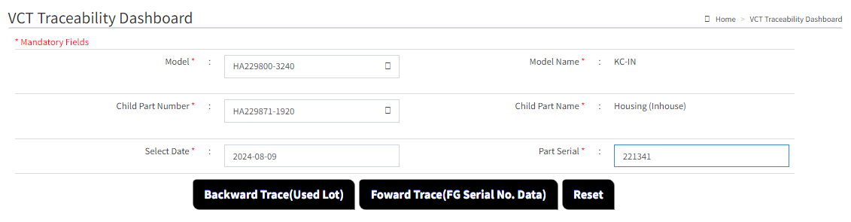

2/13
1. Modify Backward & Forward Traceability , Combined traceability search ,for LINE-2 and LINE 1 separated by line in dashboard for better visualization.
Select Model , Child part Number ,Date, Serial Number and click on the Backward Trace(Used Lot ) Button , new window will appear which will show the Suspected Lot Number Line Wise for Line 2 and Line 1.

Slide 3
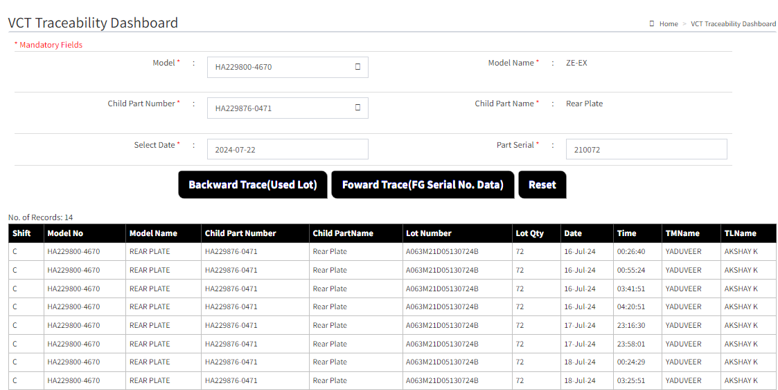
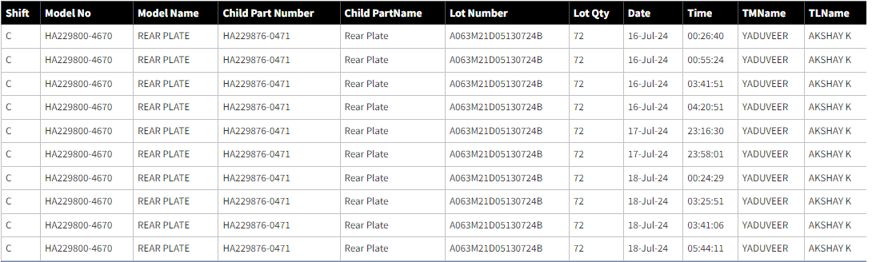
3/13
For L2 Suspected lots.
After traceability it will show the data first for the line which customer claim has been reported after that for another line.
For L1Suspected lots.
Line
2
2
2
2
For Line 2
2
2
2
2
2
2
1
1
For Line 1
1
1
1
1
1
1
From this , we can see the backward lot trace data for both lines( Incase if same lot was used in both line. )
For particular model (incase if Lot was used on only one line , it will show only the data for that line and for another line it will show
* this model is not used on this line.(name of line )

Slide 4
4/13
Incase if the suspected Lot is used on only line 2 , it will show data like this and vice-versa.
Line
2
2
2
2
For Line 2
2
2
2
2
2
2
1
This Lot is not used on the LINE-1

Slide 5
5/13
Suspected Lot Number Line wise .
After getting data for backward Trace ,Click on the Forward Trace Button to get serial number details for suspected lot.
Line
2
2
2
For Line 2
2
2
2
2
2
2
2
1
1
For Line 1
1
1
1
1
1
1

Slide 6
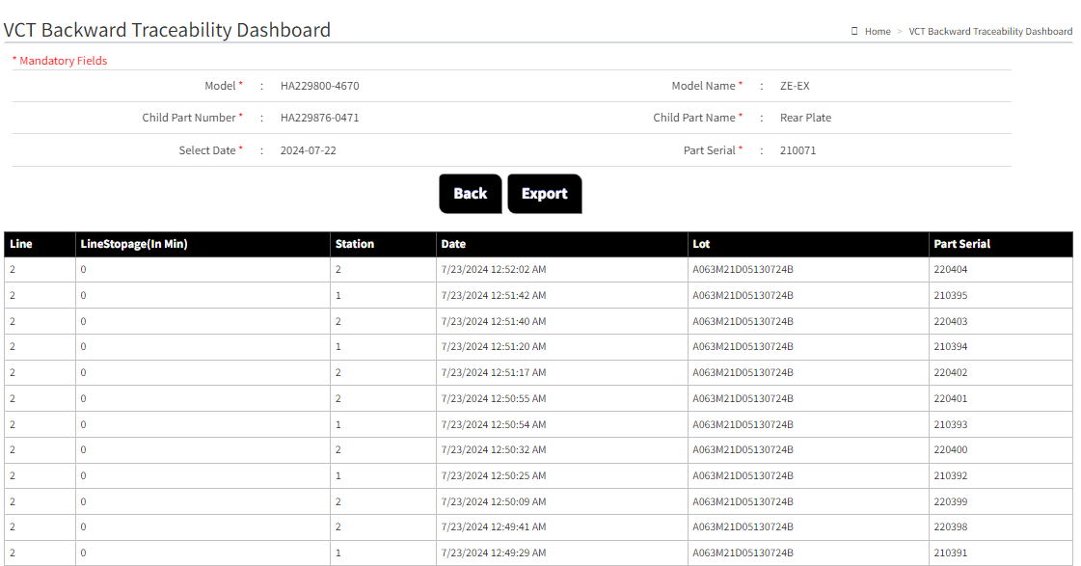
6/13
Suspected Serial Number for Suspected Lot
1
1
1
1
1
1
1
1

Slide 7
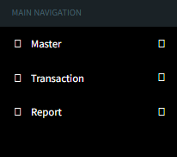

7/13
2. Add new row Direct Lot Number in Lot Info in main Navigation side bar .
VCT Traceability Dashboard
Mandatory fields *
In Main Navigation , Add new Entry Lot Info ,will used for the searching suspected serial number Line wise Using Particular LOT.
Lot Info
a. Direct Lot Info check
b. Lot Report Download
Select Line * :
L1
Add new row , Select line *
Select Line from Dropdown Menu.
L2
Model * :
Model Name* :
After modification new Navigation Side bar
Child Part Number * :
Child Part Name * :
Enter Lot * :
Entry desired lot for info.
Add new row ,Enter Lot *
A063M21D05130724B
Add new Button ,Search*
Lot Number

Slide 8
8/13
After clicking on search , it will show the data for that particular LOT entry (A063M21D05130724B), and we should be able to export csv date.
Line
2
2
2
For Line 2
2
2
2
2
2
2
2
1
1
1
For Line 1
1
1
1
1
1

Slide 9
9/13
3. Add new row report download in Lot Info in main Navigation side bar .
VCT Traceability Dashboard
Mandatory fields *
In, Lot Info ,in b. we can download report for any mode selecting date range will used for the searching suspected serial number Line wise Using Particular LOT.
Lot Info
a. Direct Lot Info check
b. Lot Report Download
Select Line * :
L1
Add new row , Select line *
Select Line from Dropdown Menu.
L2
Model * :
Model Name* :
After modification new Navigation Side bar
Child Part Number * :
Child Part Name * :
Select from date*
Select to date*
…………Search
Add new Button ,Search*
Click on the search Button

Slide 10
10/13
4. Combine child part name with the child part number
Child Part Number * :
HA229871-0781 (Housing Inhouse)
We will combine child part name with child part number like this for All Models.
HA229861-2410 (Rotor Inhouse)
VN229861-2410 (Rotor CKD)
Pls Modify this like
Child part Number ( Name) *
HA229852-0700 (Sprocket Universal)
229852-0700 (Sprocket CKD)
HA229852-0700 (Sprocket ARUN)
HA229873-0080 (Bush Stopper Local USHA)
HA229873-0080 (Bush Stopper CKD)
HA229865-0170 (Sleeve pin guide)
HA229863-0190 (Pin Stopper Local USHA)
HA229863-0190 (Pin Stopper CKD)
229827-0340 (Bolt)
HA229869-0170 (Bushing Vane Sundaram)
HA229869-1560 (Bushing Vane Porite)
229867-0070 (Spring Stopper)
229884-0010 (Chip Vane seal)
229885-0010 (Spring Vane seal)

Slide 11
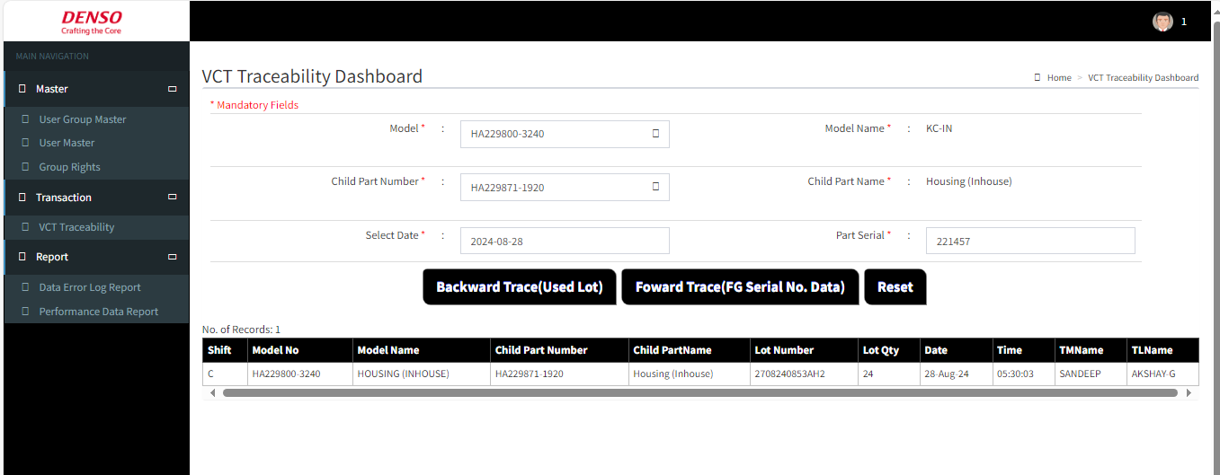

5. Add export button for Backward Traceability (Used Lot)
11/13
Add export button
On VCT Traceability Dashboard add Export Button for Backward Trace (Used Lot)

Slide 12
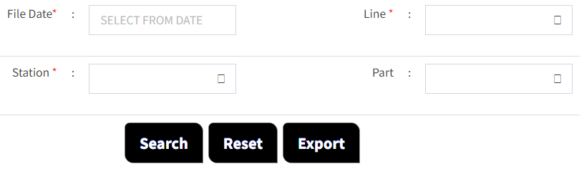
12/13
6. To Export same performance data csv.
Mandatory fields *
To export same file for performance csv data.

Slide 13
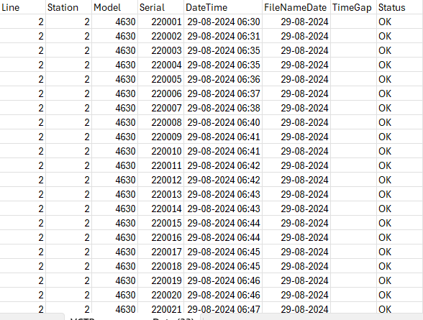
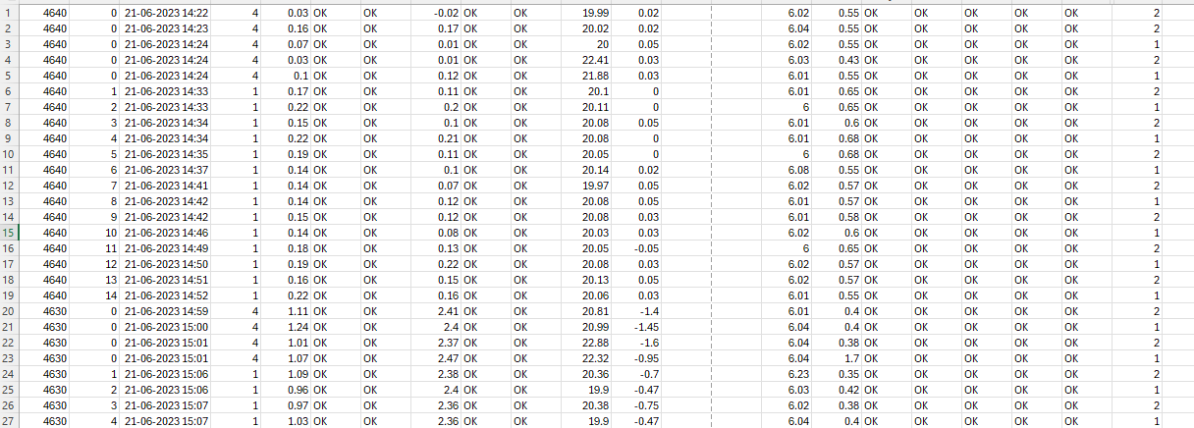
13/13
Currently we get this csv file .
To export this same csv file for performance data.

